Slide 1
SYSTEMS ANALYSIS AND DESIGN
Nguyen Thanh Binh, Nguyen Quang Vu, Le Viet Truong, Nguyen Thi Hanh, Vo Van Luong, Le Thi Bich Tra
Faculty of Computer Science

Slide 2
Static structural modelling
Class diagrams
Object diagrams

Slide 3
Views
Static view
Class diagrams
Object diagrams
Architectural view
Package diagrams
Component diagrams
Users view
Use-case diagrams
Dynamic view
Interaction diagrams
State diagrams
Activity diagrams
Deployment view
Deployment diagrams

Slide 4
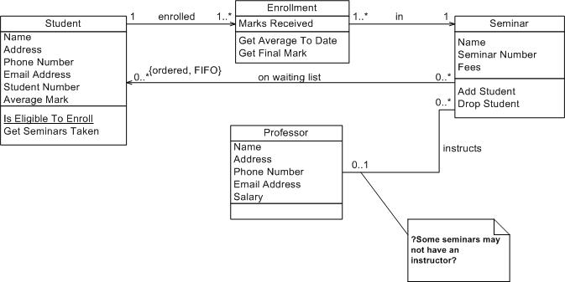
Class diagrams
Class diagrams
consist of a set of classes, interfaces and their relationships
represent the static view of the system
can produce / build the skeleton of the system
Modelling class diagrams is the essential step in object-oriented design

Slide 5
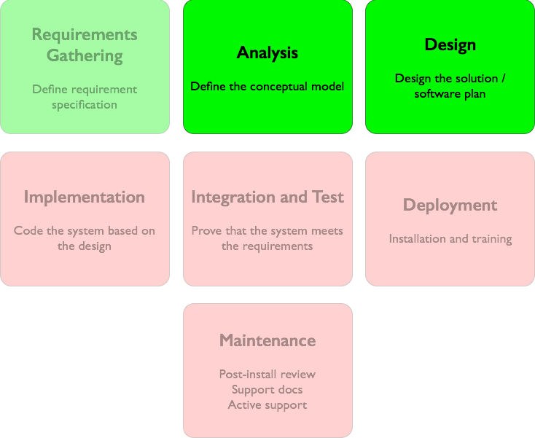
Analysis class diagram v.s Design class diagram
Two main types of class diagrams
Conceptual/Analysis class diagram (domain model)
is developed in the analysis phase
describes the system from the “user point of view”
Design class diagram
is developed in the design phase basing
describes the system from the “software developer point of view”

Slide 6
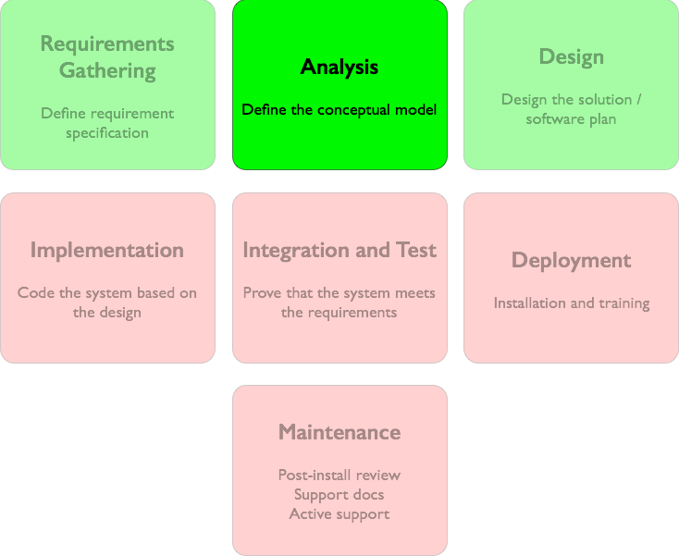
Analysis Class Diagram
Conceptual/analysis class diagram (domain model)
is constructed in the analysis phase
captures the concepts recognised by user/customer/stakeholder
doesn’t contain information of how the software system should be implemented
Student
Address
1
lives at
1
Street
City
State
Postal Code
Country
Name
Phone Number
Email Address
Student Number
Average Mark
Is Eligible to Enroll
Provide Seminars Taken
Validate
Output As Label
Analysis class diagram

Slide 7
Sale
Payment
Pays-for
1
1
Date
Time
Amount
Is Eligible to Enroll
Provide Seminars Taken
Validate
Output As Label

Slide 8
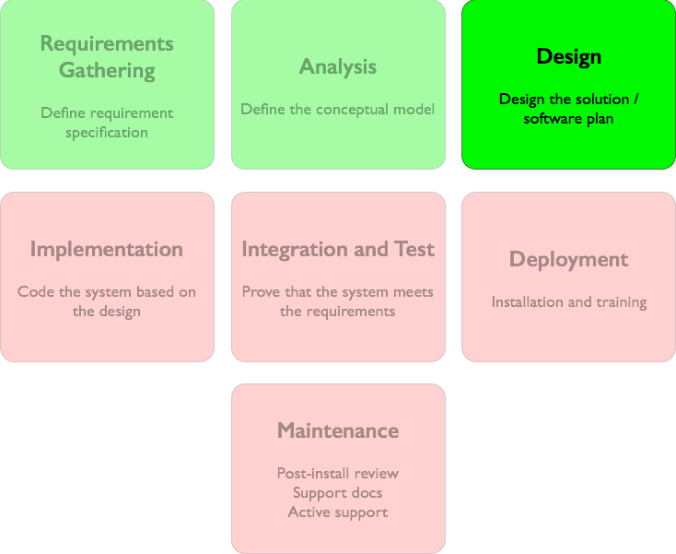
Design Class Diagram
Design class diagram
is construct in the design phase
a detail version of the analysis class diagram
an analysis class may correspond to several design classes
contains information about how the software system should be implemented
attributes’ and methods’ visibility
attributes’ and methods’ name conform to the target programming language
Student
Address
- Name: String
- phoneNumber: int
- emailAddress: String
- studentNumber: int
- averageMark: float
1
lives at
1
- street: String
- city: String
- state: String
- postalCode: String
- country: String
address
+ bool isEligibleToEnroll()
+ List getTakenSeminars()
+ bool validate()
+ String outputAsLabel()
Design class diagram (for Java implementation)

Slide 9
Analysis Class Diagram v.s. Design Class Diagram
Student
Address
Name
Phone Number
Email Address
Student Number
Average Mark
1
lives at
1
Street
City
State
Postal Code
Country
Is Eligible to Enroll
Provide Seminars Taken
Validate
Output As Label
Analysis class diagram
Student
Address
- Name: String
- phoneNumber: int
- emailAddress: String
- studentNumber: int
- averageMark: float
1
lives at
1
- street: String
- city: String
- state: String
- postalCode: String
- country: String
address
+ bool isEligibleToEnroll()
+ List getTakenSeminars()
+ bool validate()
+ String outputAsLabel()
Design class diagram (for Java implementation)

Slide 10
Class
UML class
represents the class or interface concept of object-oriented programming language
consists of a set of attributes and operation
can be graphically represented in several forms
ClassName
ClassName
ClassName
ClassName
attribute1
attribute2
…
operation1
operation2
…
attribute1
attribute2
…
operation1
operation2
…
class ClassName {
…
};
C++
ClassName
public class ClassName {
…
};
Java

Slide 11
Attributes
Attributes represent the necessary data of class instances
Attributes can have
a type
simple type
number : integer
length : double
text : string
complex type
center : Point
date : Data
A value by default
number : integer = 10
A list of possible value
color : Color = red {red, blue, purple, yellow}
Person
name : string
firstName : string
dateOfBirth : Date
nbChildren : integer = 0
married : Boolean = false
profession : string = « not defined »

Slide 12

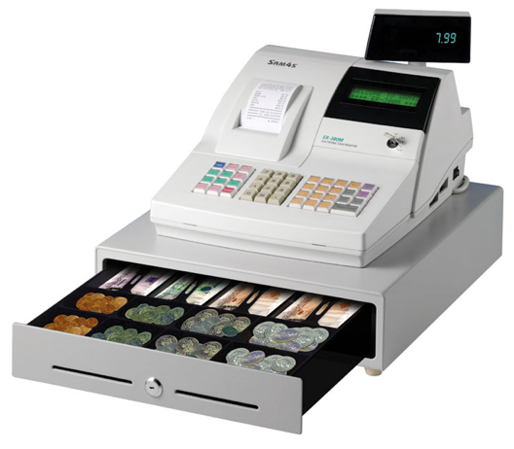

Attributes
An attribute represents only the data related to the class that has this attribute
Example
Cashier
name : string
registerNumber : int
Cashier
Register
name : string
number : int

Slide 13
Attributes
Identifying attributes
Attributes are numbers or strings
Since attributes represent the characteristics of the objects
Distinguishing between attributes and classes
If a characteristic of a class is not capable of doing something, then this is possibly an attribute
If we doubt that an attribute is a class, then it is considered as a class
Does that salary is an attribute of Person class?
If in doubt, then we consider that the salary is a class.

Slide 14
Operations / Methods
Operations represent the behaviours of instance of the class
The behaviour of a class includes
The getters and setters that manipulate the data of class instances
A certain number of tasks associated with the responsibility of the class
Operations can have
a name
area, calculate, …
a returned type
area() : double
arguments with type
move(p : Point)
Circle
center : Point
radius : double
center
radius
getCenter() : Point
setCenter(p : Point)
getRadius() : double
setRadius(r : double)
area() : real
move(p : Point)

Slide 15
Derived attributes
Attributes can be deducted from other attributes
age of a person can be derived from date of birth
{age = (currentDate – dateOfBirth)/365}
Person
Person
name : string
firstName : string
dateOfBirth : Date
/ age
nbChildren : integer = 0
married : Boolean = false
name : string
firstName : string
dateOfBirth : Date
nbChildren : integer = 0
married : Boolean = false
age()
High level design
Detailed design

Slide 16
Visibility
Attributes and operations have the visibility
Public
visible outside the class
notation “ + ”
Protected
visible only to objects of the same class and objects of sub-classes
notation “ # “
Private
visible only to objects of the class
notation “ - “
Shape
– origin : Point
+ setOrigin(p : Point)
+ getOrigin() : Point
+ move(p : Point)
+ resize(s : real)
+ display()
# pointInShape(p : Point) : Boolean

Slide 17
Relationship types
Relationships between classes
Association
Semantic relation between classes
Inheritance
A class can inherit one or more classes
Aggregation
An association shows a class is a part of another class
Composition
A strong form of aggregation
Dependency
shows the dependency between classes

Slide 18
Association
An association
is used to show how two classes are linked together
expresses a bidirectional semantic connection between classes
is an abstraction of the links between instances of classes
Notation
Each end of an association is called a role
A role shows the purpose of the association
A role can have
an name
an expression of multiplicity
1
name of the association
*
ClassA
ClassB
role 1
role 2

Slide 19
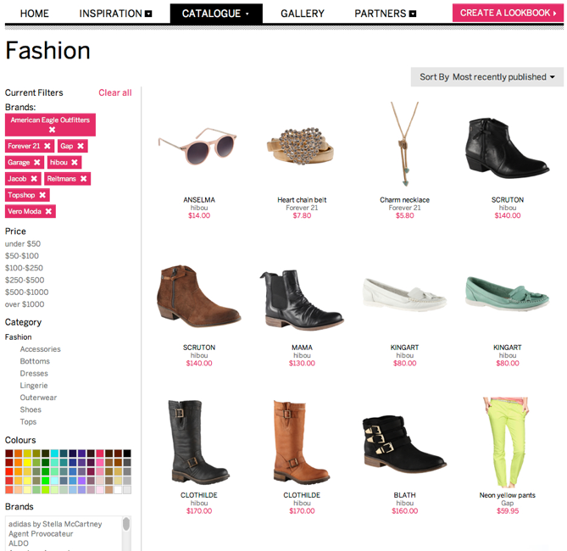
Association
Multiplicity
defines how many instances of a class A are associated with an instance of class B
Different expressions of multiplicity
1 : one and only one
0..1 : zero or only one
m..n : from m to n (integer, n >= m >= 0)
n : exactly n (integer, n >= 0)
* : zero or many
1..* : from one to many
Catalog
1
contains
*
Product

Slide 20


Association
Multiple associations
Two classes can have several associations between them
Flight
*
flight-to
1
Airport
*
flight-from
1

Slide 21
Association
Directional association and attributes
By default, the associations are bi-directional
However, associations can be directional
Example
The navigability pointing from Cashier to Sale shows that an attribute with Sale type
This attribute is called currentSale
Another form of representation: use of attributes
Cashier
1
Sale
currentSale
Cashier
Sale
currentSale : Sale
…
…

Slide 22
Association
Directional association and attributes
When do we use the directional association or attribute?
We use the attribute for “primitive” data types, such as Boolean, Time, Real, Integer, …
We use the directional association for other classes
To better see the connections between classes
It is just to better represent, these two ways are semantically equivalent
Example
Cashier
1
Sale
id : Number
…
currentSale
time : Time

Slide 23
Association
Directional association and attributes
Another example
Catalog
Product
products : Product[1..*]
…
id : Number
Catalog
1..*
Product
products
…
id : Number
public class Catalog {
private List<Product> products =
new ArrayList<Product>();
// …
}

Slide 24
Association
Association classes
An association class allows an association to be considered as a class
When an attribute cannot be attached to any of the two classes of an association
Example
*
*
Person
Company
Employment
salary
position
Company
*
Employment
*
Person
salary
position

Slide 25
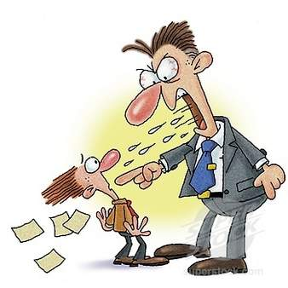
Association
A class can be associated to itself
example
Person
employer
employee
Employee
Employer

Slide 26
Inheritance
A class can have several sub-classes
Polygon
inheritance
Parallelogram
Triangle
Rectangle
Lozenge
Square

Slide 27
Inheritance
Substitution principle
All subclass objects can play the role of an object of its parent-class
An object of a subclass can override an object of its superclass
Informally
A subclass is a kind of superclass
Example
A triangle is a polygon
Polygon
is a
Triangle

Slide 28
Inheritance
The subclasses are also called specialised classes
Parent-classes are also called general classes
The inheritance is also called the specialisation or generalisation
General class
Polygon
specialisation
generalisation
Specialised class
Triangle

Slide 29

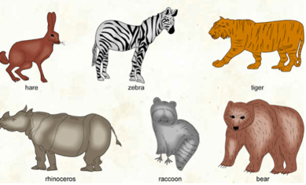
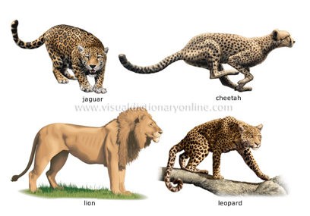
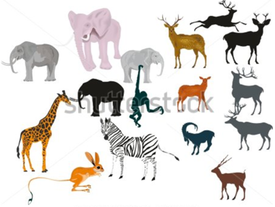
Inheritance
The (optional) discriminator is a label describing the criterion that the specialisation bases on
Animal
discriminator
habitat
foodType
AquaticAnimal
TerrestrialAnimal
CarnivorousAnimal
HerbivorousAnimal

Slide 30
Aggregation
An aggregation is a form of association that expresses a stronger (than normal association) coupling between class
An aggregation is used between two classes
master and slave: “belongs to”
whole and part: “is a part of”
Notation
The symbol denoting the place of aggregation of the aggregate side
Examples
Whole
*
Part
aggregation
Employer
1..*
*
Employee
University
1..*
*
Student

Slide 31
Composition
A composition is a strong form of aggregation
A composition is also a “whole-part” relationship but the aggregate is stronger
If the whole is destroyed then parts will be also destroyed
Example
Whole
*
Part
composition
3
Point
1
Triangle
Circle
radius
1
Style
color
isFilled
1

Slide 32
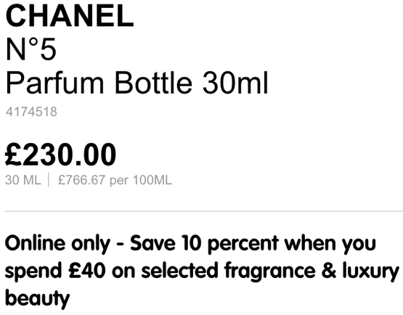
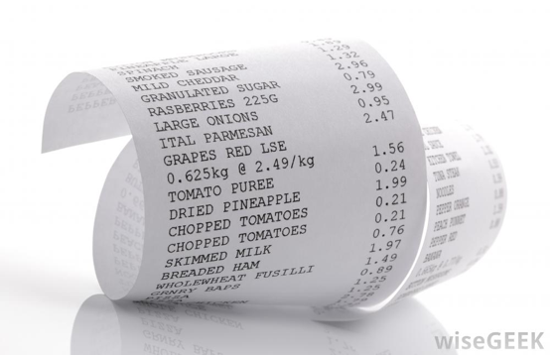

Dependency
A class may depend on another class
The dependency between classes can be implemented in different ways
Having an attribute with the type of another class
Sending a message using an attribute, a local variable, a global variable of another class or static methods
Receiving a parameter having type of another class
Example
dependency
Sale
…
updatePrice(ProductDesc)
ProductDesc

Slide 33
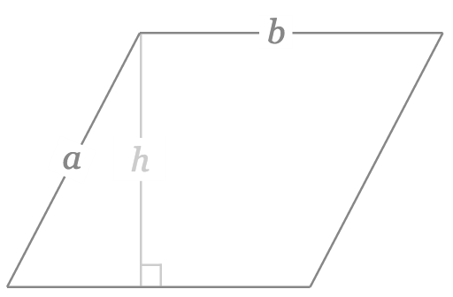
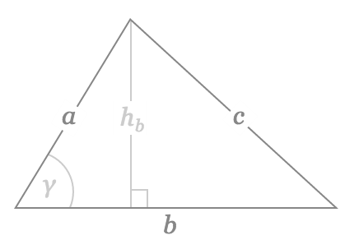
Abstract class
An abstract class is a class that has no instances/objects
inheritance: area(), perimeter()
polymorphism: area()
Parallelogram = b * h Triangle = (h * b) / 2
Notation
Abstract Class
Polygon
{abstract}
Polygon
area()
perimeter()
area()
perimeter()
Parallelogram
Triangle
Parallelogram
Triangle
area()
area()
area()
area()

Slide 34
Interface
An interface
describes a portion of the visible behaviour of a set of objects
is very similar to an abstract class that contains only abstract operations
specifies only the operations without implementation
Two notations
interface
Cashier
« interface »
Cashier
ATM
ATM

Slide 35

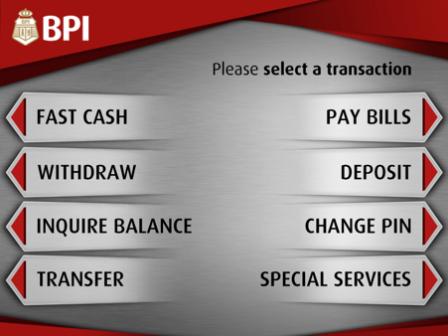


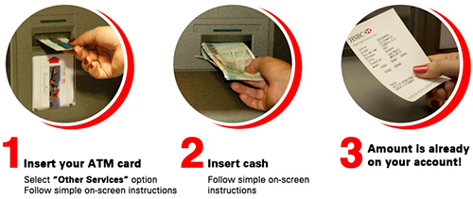
Interface
« interface »
Cashier
withdraw
deposit
Example
Person
Machine
Employee
ATM

Slide 36
Generic class
A generic class (or parameterised) allows to consider the types of data as parameters
Generic classes are often used for the types of collection classes: vector, table, stack, …
Notation
Example
“template” in C++
Generic type in Java
List<Integer> intList = new ArrayList<Integer>();
Parameter
Generic Class
T
List
intList =
5 | 3 | 9 | 11

Slide 37
Description class
Description class contains information describing the objects
increase cohesion, reusability
Example
Description of a product with certain information
Product
idProduct
name
price
seriesNumber
colour
Solution 1 : no description class
Product
seriesNumber
colour
ProductDesc
idProduct
name
price
*
is-described-by
1
Solution 2 : use description class

Slide 38
Description class
When do we use description class?
Reduce redundant information
Avoid repetition of information
Describe some objects independent of real-world objects
Keep the information in the object even if real-world objets are removed
Example
Describe the information (number, time, date, …) of a flight
Flight
number
time
date
Flight
time
date
FlightDesc
number
…
*
is-described-by
1
Description class ?
Description class ?
Description class ?

Slide 39
Building class diagrams
Class diagrams are built at different stages and at different levels
Domain model
Model a set of conceptual classes (concepts) and the relationships between them
System model
Model all classes and their relationships, including the architecture classes and user interface classes

Slide 40
Building class diagrams
Suggested steps to build class diagrams
Build the domain model
Identify conceptual classes
Identify the relationships
Identifier the attributes
Identify the inheritances and the interfaces
Determine the main responsibilities of each conceptual class
Build the system model
Introduce new classes
Detail the attributes
Detail the relationships
Decide the operations of each class
During the development, refine progressively the class diagrams until satisfaction
Add or remove classes, attributes, operations, relationships

Slide 41
Building class diagrams
Building domain model
The domain model is the important model in object-oriented analysis
This model is also called the analysis class diagrams

Slide 42
Building class diagrams
Class diagrams are progressively built at different phases of software development process
Student
Address
Name
Phone Number
Email Address
Student Number
Average Mark
1
lives at
1
Street
City
State
Postal Code
Country
Is Eligible to Enroll
Provide Seminars Taken
Validate
Output As Label
Analysis class diagram
Student
Address
- Name: String
- phoneNumber: int
- emailAddress: String
- studentNumber: int
- averageMark: float
1
lives at
1
- street: String
- city: String
- state: String
- postalCode: String
- country: String
address
+ bool isEligibleToEnroll()
+ List getTakenSeminars()
+ bool validate()
+ String outputAsLabel()
Design class diagram (for Java implementation)

Slide 43
Building class diagrams
Identifying classes
The question “How to find classes?”
The concepts in the studied domain can be also classes
These concepts are called conceptual classes
So, we firstly identify the conceptual classes, and then other classes are added during the development
The principles for finding conceptual classes
Use of a list of categories
Identification of nouns

Slide 44
Building class diagrams
Identifying classes
Use of a list of categories
Categories of conceptual classes | Examples
transaction (of business) | Reservation, Payment
product ou service relating to the transaction | Product, Flight
where transactions are recorded? | Cash desk, Cash
actors of use-cases | Cashier, Customer
location (of service, of transaction) | Station, Store
important events | purchase
physical objects | Car
description of things | Description of products
catalog | Product catalog
containing things | Store
other collaboration systems | Bank, database
organisations | University
policy, principle | Tax
…

Slide 45
Building class diagrams
Identifying classes
Identification of nouns
Review written documents such as specification or description of use-cases
Extract names and consider them as conceptual class candidates
Remove the nouns which
are redundant
are vague or too general
aren’t conceptual classes by experience and knowledge in the context of the application

Slide 46

Building class diagrams
Identifying classes
Identification of nouns from use-case spec
Example
Actions of actor | Actions of system
The customer comes to the cash desk with the products to buy
The cashier encodes the identifier of each product If a product has more than one item, the cashier inputs the number of items | The cash desk displays the description and price of the product This number is displayed
After having encoded all of the products, the cashier signals the end of the purchase | The cash desk calculates and displays the total amount that the customer has to pay
The cashier announces the total amount to the customer
The customer pays | The cash desk displays the balance
The cashier input the amount of money paid by the customer

Slide 47
Building class diagrams
Identifying classes
Identification of nouns
Example (continue)
Actions of actor | Actions of system
The cashier receives the cash payment | The cash desk prints the receipt
The cashier gives change to the customer and the receipt | The cash desk saves the purchase
The customer leaves the cash desk with the bought products

Slide 48
Building class diagram
Candidate classes from nouns identified from use-case description
customer, cash desk, product, item, cashier, purchase, change

Slide 49
Building class diagrams
Identifying the relationships and attributes
Starting with central classes of the system
Determining the attributes of each class and associations with other classes
Avoiding adding too many attributes or associations to a class
To better manage a class

Slide 50
Building class diagrams
Identify the relationships
A association should exist between class A and class B, if
A is a service or product of B
A is a part of B
A is a description for B
A is a member of B
A is connected to B
A possesses B
A controls B
…
Specify the multiplicity at each end of the association
Label associations

Slide 51
Building class diagrams
Identifying attributes
For each class, determine the information needed to store according to the requirement specification or use-case
Example: Cashier needs an identifier, a name, …
Principle to determine attributes
An attribute represents only data related to the class that owns the attribute
If a subset of the attributes form a coherent group, it is possible that a new class is introduced
Determine only the names of attributes at this stage (i.e., analysis phase)

Slide 52
Building class diagrams
Identifying attributes
Example
An attribute represents only data related to the class that owns the attribute
If a subset of the attributes form a coherent group, it is possible that a new class is introduced
Cashier
name
cashDeskNumber
Cashier
name
1
works
1
CashDesk
deskNumber
Person
name
number1
road1
city1
number2
road2
city2
address
Person
name
*
Address
number
road
city

Slide 53
Building class diagrams
Identifying inheritances
Two approaches
Bottom-up
Generalisation: group similar classes to create super-classes
Top-down
Specialisation: build sub-classes from existing general classes
Parallelogram
Rectangle
Bottom-up
Top-down
Parallelogram
Losange
Rectangle
Losange

Slide 54
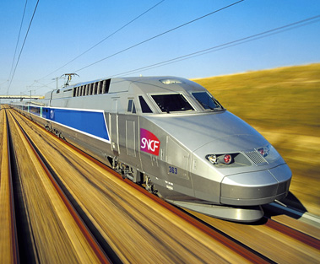
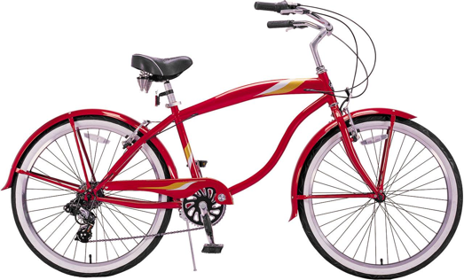

Building class diagrams
Identifying interfaces
Create interfaces rather than super-class, if
It is necessary to realise different implementations of the same class
Two classes to generate share the operations that are not similar
The class to generalise already has its own super-class
<<interface>>
Vehicle
run()
Airplane
Train
Bicycle

Slide 55
Building class diagram
Determining the responsibilities of classes
A responsibility is one or several tasks that the system has to perform
Each functional requirement must be attributed to one of the classes
All the responsibilities must be attributed to one of the classes
If a class has too many responsibilities, it must be divided into several classes
If a class has no responsibility, it should be probably be useless
If responsibility cannot be assigned to any class, a new class can be introduced
The responsibilities can be determined by analysing the actions/verbs in the use-case specification.

Slide 56
Building class diagrams
Developing design class diagrams
Basing on analysis class diagrams (domain models)
Detailing analysis class diagrams
Introducing new classes, if necessary
For example, an association of class becomes a new class
Detailing attributes
Adding and detail relationships
Determining operations/functions

Slide 57
Building class diagrams
Detailing attributes
Determining the types of attributes
Using primitive types: boolean, int, real, …
Defining new type for an attribute (new class), if
It consists of several sections
It has other attributes
It is associated with other operations
Determining initial values if necessary
Determining the visibility of attributes
Detailing relationships
Introducing relationships according to newly added classes
Specifying if an association is an aggregation or a composition
Naming the relationship
Giving the direction

Slide 58
Building class diagrams
Determining the operations/functions of each class
getters and setters
Operations are used to achieve the identified responsibilities
A responsibility can be carried out by several operations
Determining the visibility of operations
Essential operations carrying out responsibilities are declared “public”
Operations serving only in the class are declared “private” or “protected” if the class should be inherited

Slide 59
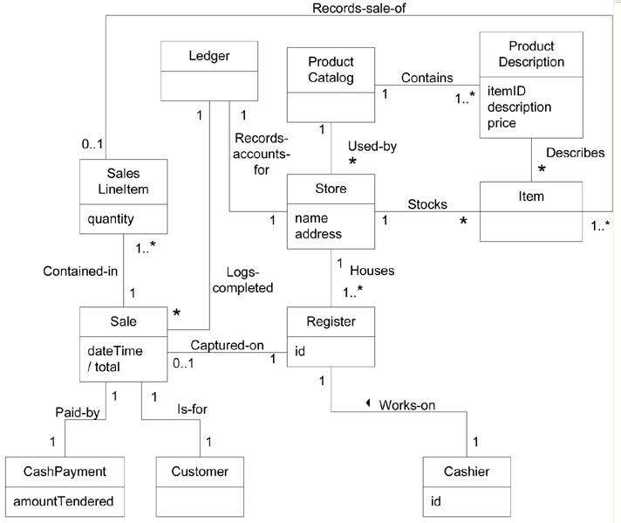
Building class diagrams
Example: supermarket cash register system

Slide 60
Object diagrams
Objects
Objects are instances of classes
Notation
Values of attributes can be indicated
Name of object is underlined
Object
Class
Circle
objCircle
center
diameter
center = (0, 0)
diameter = 5
circleObj
circleObj:Circle
:Circle

Slide 61
Object diagrams
Objects
Three types of diagrams with objects
Static view
Object diagrams
Dynamic view
Sequence diagrams
Collaboration diagrams
Static view
Class diagrams
Object diagrams
Architectural view
Package diagrams
Component diagrams
Users view
Use-case diagrams
Dynamic view
Interaction diagrams
State diagrams
Activity diagrams
Deployment view
Deployment diagrams

Slide 62
Object diagrams
Object diagrams
represent a set of objects and links between them
are static views of instances of the elements appearing in class diagrams
An object diagrams is an instance of a class diagram
:Wheel
Motor
1
4
Wheel
:Motor
:Wheel
:Wheel
:Wheel
Class diagram
Object diagram

Slide 63
Project (1)
Divide groups of 4-5 students
Each group chooses a problem
Building Analysis class diagrams : Choose one of the following tools:
Microsoft Visio
StarUML: http://staruml.io/
Argo UML: https://argouml.jaleco.com/
Lucidchart: https://www.lucidchart.com/pages/examples/uml_diagram_tool

Slide 64
Project (2)
Divide groups of 4-5 students
Each group chooses a problem
Building Design class diagrams : Choose one of the following tools:
Microsoft Visio
StarUML: http://staruml.io/
Argo UML
Lucidchart: https://www.lucidchart.com/pages/examples/uml_diagram_tool

